Slide 1

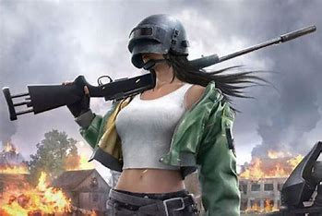

Uneeq Intrens
PUBG data Analysis Project
By: Hala ElSebai

Slide 2


Overview
Problem Statement
01
Data Validations
02
Data Visualization
03
Key Insights
04

Slide 3
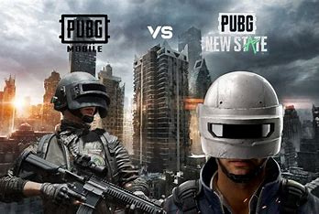
Problem Statement
Perform 'Exploratory Data Analysis' on 'PUBG Dataset ‘
Brief about Weapon and bullet type.

Slide 4
Data Validation
The dataset that will be used in this analysis is a data for PUBG Weapons .( https://drive.google.com/file/d/1rRyMj6g-QxxkfJGNabSwVLhnZ1gOkXCf/view?usp=sharing). It is available in both csv and excel format. It has been loaded to our Analytical Tool which is Power Bi.
we have 20 columns and 44 rows or records.
Below are variable descriptions for each of the columns:
Weapon Name: This identifies the specific weapon (e.g., M416, AWM).
Weapon Type: This categorizes the weapon (e.g., Assault Rifle, Sniper Rifle, SMG). This will be helpful for comparing weapons within the same category.
Damage: This indicates the base damage per shot of the weapon.
Magazine Capacity: This shows the number of rounds the weapon can hold before reloading.
Range: This represents the effective firing range of the weapon.
Bullet Speed: This indicates the speed at which the bullet travels.
Rate of Fire: This shows the number of rounds the weapon can fire per second (automatically or with sustained fire).
Shots to Chest: This specifies the number of shots required to take down an opponent with a body shot.
Shots to Hill (Head): This indicates the number of shots needed for a headshot kill.
Damage Per Second (DPS): This is a calculated value that considers both damage and rate of fire, showing the weapon's overall damage output per second.
Fire Mode: This specifies the firing mode of the weapon (e.g., single, burst, automatic).
BDMG0: Body Damage level 0
BDMG1: Body Damage level 1
BDMG2: Body Damage level 2
BDMG3: Body Damage level 3
HDMG0: Head Damage level 0
HDMG1: Head Damage level 1
HDMG2: Head Damage level 2
HDMG3: Head Damage level 3

Slide 5


DATA VISUALIZATION

Slide 6
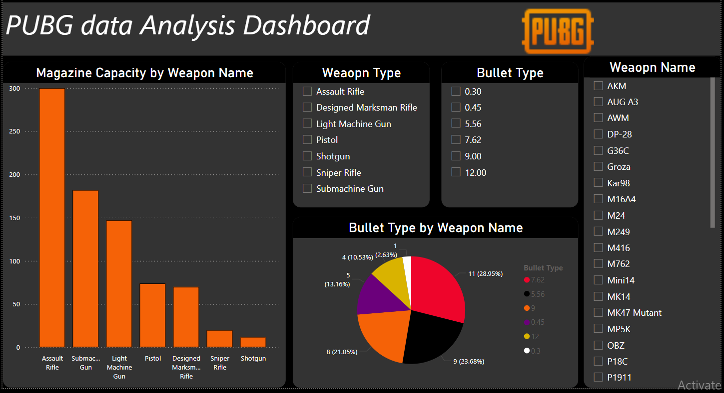

Slide 7
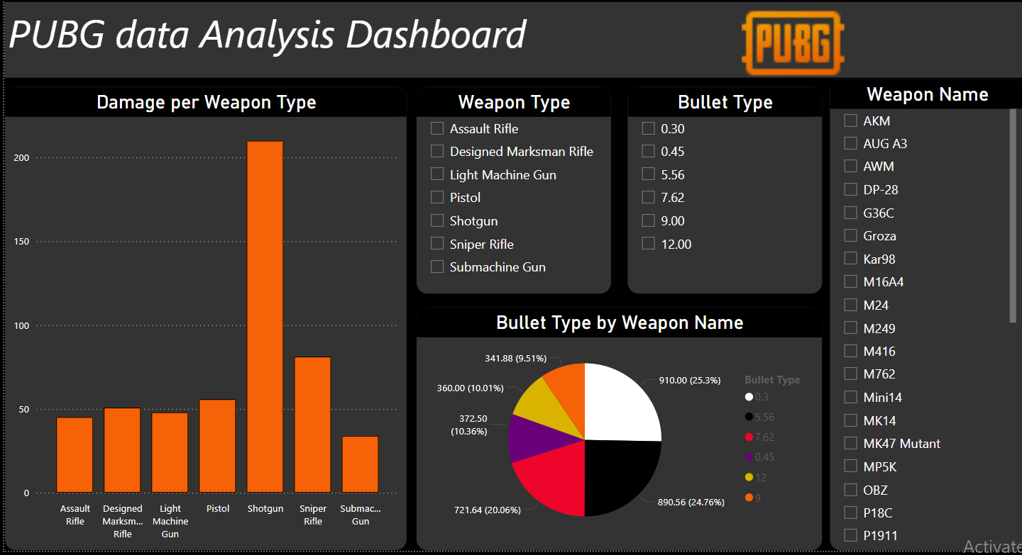

Slide 8
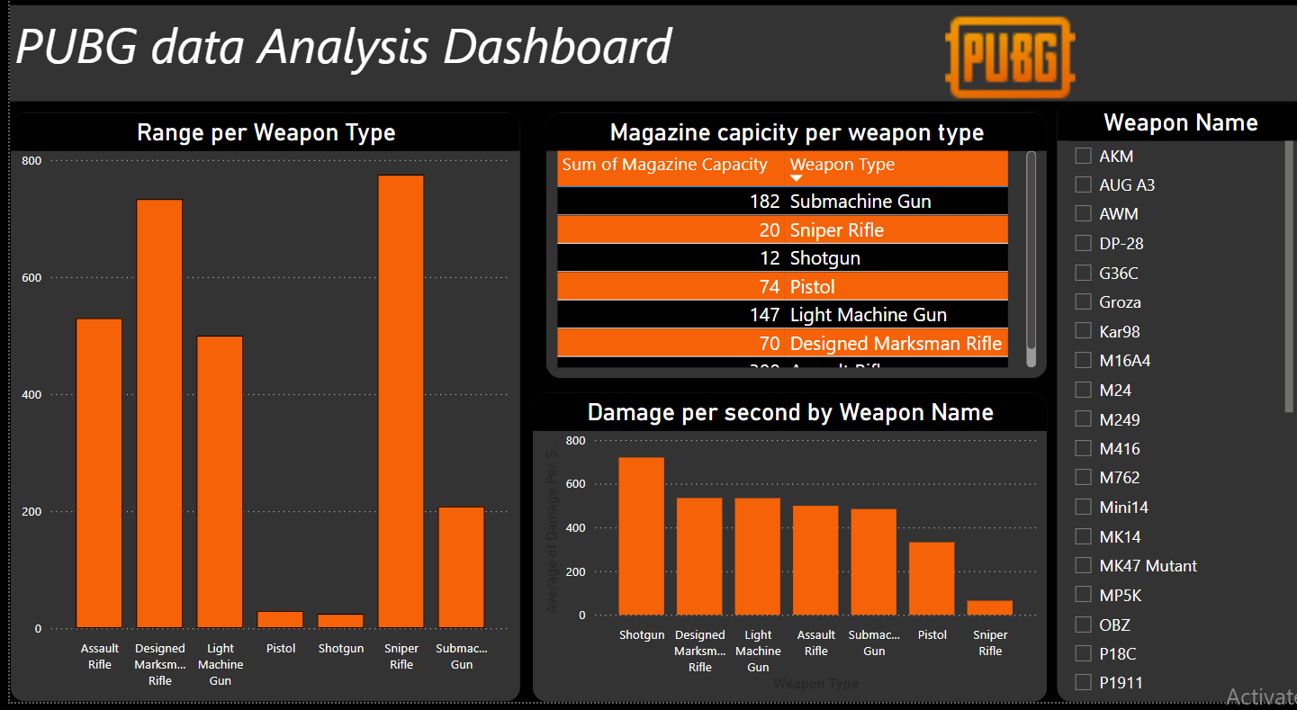

Slide 9
More weapons are Assault Rifle.
there are 10 weapons under the AR. with two bullet types [7.62 , 5.56].
There are 11 weapons under 7.62 bullet type and 9 in 5.56
Shot guns damage is more followed by Sniper Rifle.
0.3 gun has highest bullet speed i.e AWM
Sniper is most suitable weapon for Long range
Shot gun damage rate is high
By considering all the factors Shot gun is power full in short range close fights around 25-30
AR type guns are suitable for Short to average range fights
AWM is most powerful gun for Long range fights
Key Insights

Slide 10




Uneeq Intrens
THANK YOU!
Hala ElSebai
Data Analyst
01096328081
hala.elsebai98@gmail.com
Cairo,Egypt

